Slide 1
CSE 486/586 Distributed Systems Logical Time
Steve Ko
Computer Sciences and Engineering
University at Buffalo

Slide 2
Last Time
Clock skews do happen
External and internal synchronization
Cristian’s algorithm: external synchronization
Berkeley algorithm: internal synchronization
Both designed for LAN
NTP (Network Time Protocol)
Hierarchy of time servers
Estimates the actual offset between two clocks
Designed for the Internet
Logical time
For ordering events, relative time should suffice.
Will continue today

Slide 3
Brief Recap: Cristian’s Algorithm
Cristian’s algorithm
A client asks its time server.
The time server sends its time T.
The client estimates the one-way delay and sets its time.
It uses T + RTT/2
The correct time can be between [T + min, T + RTT – min]
Min one-way delay: min, max one-way delay: RTT – min
The accuracy is: +-(RTT/2 – min)
Natural next step: minimize inaccuracy
Take multiple readings and use the minimum RTT → tighter bound
For unusually long RTTs, ignore them and repeat the request → removing outliers

Slide 4
Brief Recap: NTP
The Internet
Arbitrary delays; hard to estimate one-way delay
Too many hosts; cannot rely on a few time servers
Thus, hard to apply Cristian’s algorithm
The NTP
Doesn’t estimate one-way delay; instead estimate the actual offset between two clocks
Uses a hierarchy of servers → scales better
How to estimate the actual offset

Slide 5
Theoretical Base for NTP
Server B
T
T
i
-2
i-1
Time
m
m'
(with delay t)
(with delay t’)
Time
Server A
T
T
i
-
3
i
Many NTP peers talk; apply a data filtering algo. then keep the 8 most recent pairs of <o_{i}, d_{i}>, and selects the minimum d_{i}

Slide 6
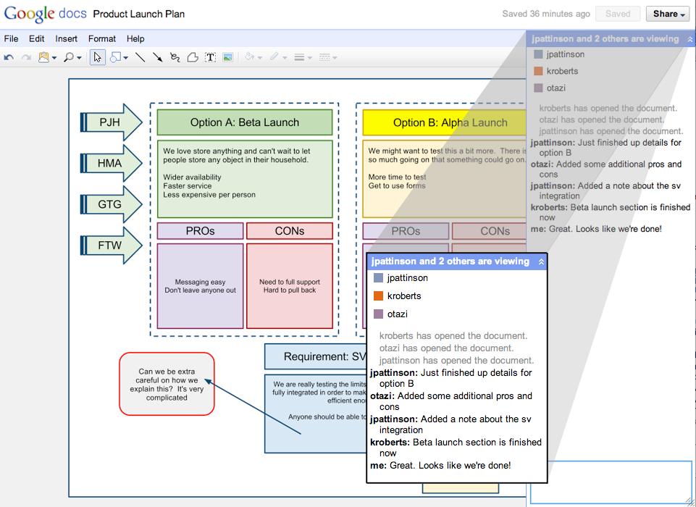
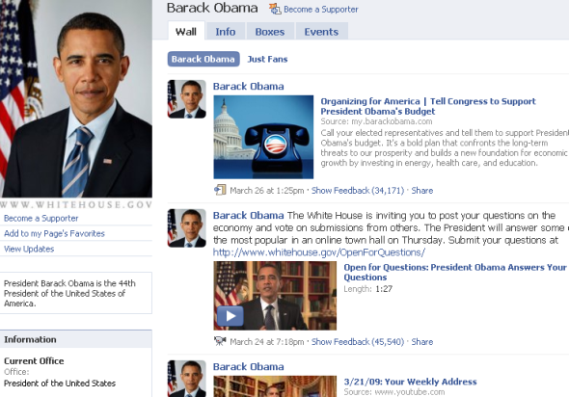
Ordering of Events
Arises in many different contexts…

Slide 7
Basics: State Machine
State: a collection of values of variables
Event: an occurrence of an action that changes the state, (i.e., instruction, send, and receive)
As a program,
We can think of all possible execution paths.
At runtime,
There’s only one path that the program takes.
Equally applicable to
A single process
A distributed set of processes
S0
S1
S2
S3
S4
SF

Slide 8
Events Occurring at Three Processes

Slide 9
Lamport Timestamps

Slide 10
Logical Clocks
Lamport algorithm assigns logical timestamps:
All processes use a counter (clock) with initial value of zero
A process increments its counter when a send or an instruction happens at it. The counter is assigned to the event as its timestamp.
A send (message) event carries its timestamp
For a receive (message) event the counter is updated by max(local clock, message timestamp) + 1
Define a logical relation happened-before (→) among events:
On the same process: a → b, if time(a) < time(b)
If p1 sends m to p2: send(m) → receive(m)
(Transitivity) If a → b and b → c then a → c
Shows causality of events

Slide 11

Find the Mistake: Lamport Logical Time
Physical Time
p 1
0
1
2
4
3
1
p 2
3
4
0
2
2
3
6
p 3
4
0
3
5
6
8
4
7
p 4
0
5
6
7
n
Clock Value
timestamp
Message

Slide 12
Corrected Example: Lamport Logical Time
Physical Time
p 1
0
1
2
8
7
1
p 2
3
8
0
2
2
3
6
p 3
4
0
3
5
9
10
4
7
p 4
0
5
6
7
n
Clock Value
3 and 7 are logically concurrent events
timestamp
Message

Slide 13
Vector Timestamps
With Lamport clock
e “happened-before” f ⇒ timestamp(e) < timestamp (f), but
timestamp(e) < timestamp (f) ⇒ e “happened-before” f
X

Slide 14
Vector Logical Clocks
Vector Logical time addresses the issue:
All processes use a vector of counters (logical clocks), i^{th} element is the clock value for process i, initially all zero.
Each process i increments the i^{th} element of its vector upon an instruction or send event. Vector value is timestamp of the event.
A send(message) event carries its vector timestamp (counter vector)
For a receive(message) event, V_{receiver}[j] =
Max(V_{receiver}[j] , V_{message}[j]), if j is not self,
V_{receiver}[j] + 1, otherwise

Slide 15
Find a Mistake: Vector Logical Time
Physical Time
p 1
1,0,0,0
2,0,0,0
4,0,2,2
0,0,0,0
3,0,2,2
(1,0,0,0)
p 2
1,2,0,0
(4,0,2,2)
0,0,0,0
1,1,0,0
(2,0,0,0)
(1,2,0,0)
(2,0,2,2)
p 3
0,0,0,0
2,0,2,0
2,0,1,0
2,2,3,0
4,2,4,2
4,2,5,3
(2,0,2,0)
(2,0,2,3)
p 4
0,0,0,0
2,0,2,2
2,0,2,1
2,0,2,3
n,m,p,q
Vector logical clock
(vector timestamp)
Message

Slide 16
Comparing Vector Timestamps
VT₁ = VT₂,
iff VT₁[i] = VT₂[i], for all i = 1, … , n
VT₁ <= VT₂,
iff VT₁[i] <= VT₂[i], for all i = 1, … , n
VT₁ < VT₂,
iff VT₁ <= VT₂ & ∃ j (1 <= j <= n & VT₁[j] < VT₂ [j])
VT₁ is concurrent with VT₂
iff (not VT₁ <= VT₂ AND not VT₂ <= VT₁)

Slide 17
The Use of Logical Clocks
Is a design decision
NTP error bound
Local: a few ms
Wide-area: 10’s of ms
If your system doesn’t care about this inaccuracy, then NTP should be fine.
Logical clocks impose an arbitrary order over concurrent events anyway
Breaking ties: process IDs, etc.

Slide 18
CSE 486/586 Administrivia
Project 0 deadline is 2/6/12 (Monday).
Please give feedback on project 0.
One server socket (one globally) vs. two server sockets (one each)
Project 1 will be out next week (probably Wednesday).
Please form a project group of 5 people by next Wednesday.
By Sunday, if you cannot form a group of 5 people, post a public msg on Piazza, so that others can see and reply back to you.
By Wednesday, if you still cannot, then post a private msg on Piazza; the teaching staff will be match-makers.

Slide 19
Summary
Relative order of events enough for practical purposes
Lamport’s logical clocks
Vector clocks
Global snapshot overview
Consistent cut
The “snapshot” algorithm
Next: why the snapshot algorithm works & reliable multicast

Slide 20
Acknowledgements
These slides contain material developed and copyrighted by Indranil Gupta at UIUC.

